Slide 1
Micro Services

Slide 2
Monolithic vs Micro Service Architecture
“architecture, in which functionally distinguishable aspects are all interwoven, rather than containing architecturally separate components”
No single definition of micro services in industry
Very hotly debated within the SOA community
We may not be able to define it, but we normally “know it when we see it”.
Several common traits (small teams, automated deployments, independently deployable, etc.)
“style of architecture which puts the emphasis on dividing the system into small and lightweight services that are purposely built to perform a very cohesive business function, and is an evolution of the traditional service oriented architecture style” – Fowler (quoted in ieee article).

Slide 3
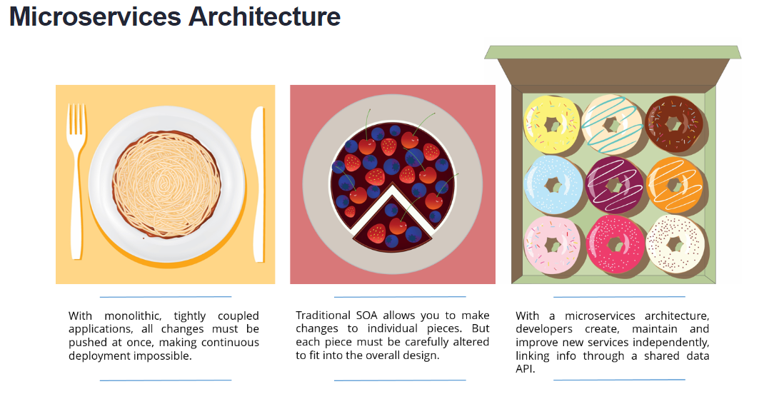
What Are Microservices
https://dzone.com/articles/what-are-microservices-actually

Slide 4
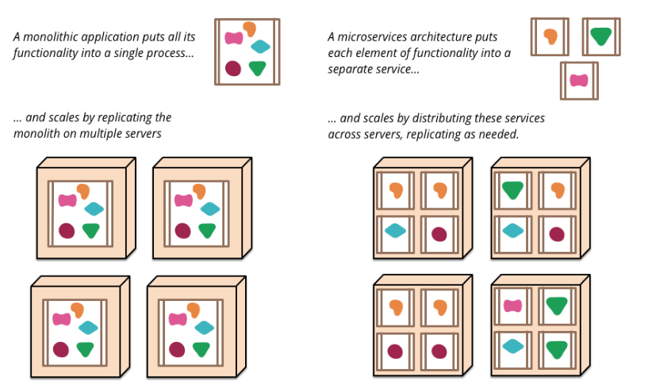
What Are Microservices
https://martinfowler.com/articles/microservices.html

Slide 5

Real World Example

Slide 6
What are we trying to solve
Long build / test / release cycles
Scalability is compromised
Lack of agility (very long time to add new features)
Software architecture is hard to maintain and evolve
System operation is difficult (module X is failing, who’s the owner?)
Lack of innovation (team always fixing issues)
Slow development pace (team always fixing issues)
Quotes from recent IT engagement
“I’m constantly having to resolve commit conflicts and merges.”
“Our last build attempt failed after 4 hours. We don’t know who broke the build as 30 commits were made”

Slide 7
Benefits of Micro Services
Improves fault isolation
Eliminates long-term commitment to a single technology stack
Reduces complexity of most “end of life” issues
Improved agility
Realize promised benefits of agile methodologies and continuous deployment
Provides the ability to “fail fast” and recover fast

Slide 8
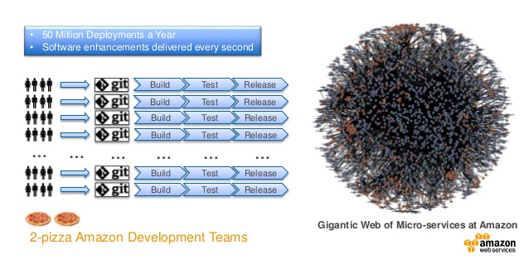
Micro-Services Benefits at Amazon

Slide 9
What’s the Down Side
Can be complex
Have to handle calls between applications
Extra security concerns
Remote calls experience latency
Premium placed on automated deployment
Increased infrastructure costs
Increased security vulnerabilities
More complex data management

